Slide 1
SCRUM
COMP 319
© University of Liverpool
slide <number>
Notes:
COMP319

Slide 2
SCRUM history
In 1986, Hirotaka Takeuchi and Ikujiro Nonaka
More an observation of good practise in manufacturing (e.g. cameras, photocopiers, PCs) than an theoretical invention
Team covers all aspects of development
  Product requirements
  Hardware engineers
  Software engineers
  Production engineers
Move from relay approach to
COMP319
© University of Liverpool
slide <number>

Slide 3
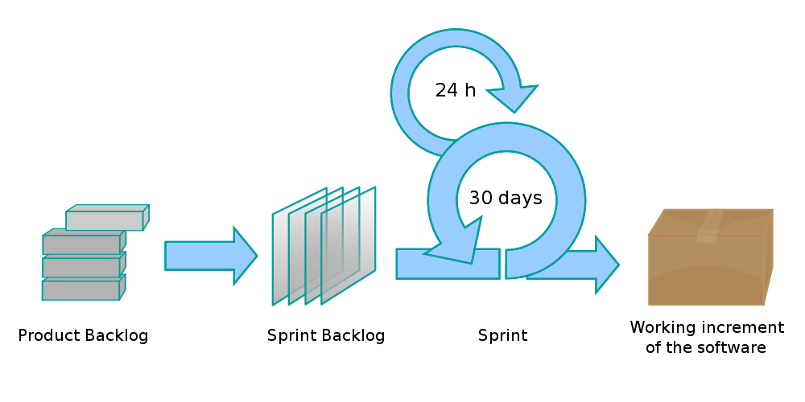
Scrum process
COMP319
© University of Liverpool
slide <number>
Notes:
Sprint
The development is broken into a series of development phases called Sprints, these will typically run from 1 week to something
like a month.
The product backlog is:
All the stuff that remains left over and not currently added to the project.
The sprint backlog
This is the list of stuff that is committed for the development into the next Sprint.
Apart from the actual Sprint, each day the work is reviewed in a daily Scrum meeting (typically 15 minutes):
What have you done since yesterday?
What are you planning to do today?
Do you have any problems that would prevent you from accomplishing your goal? (It is the role of the ScrumMaster to facilitate resolution of these impediments, although the resolution should occur outside the Daily Scrum itself to keep it under 15 minutes.)
COMP319

Slide 4
Daily Scrum
15 minute meeting (start of day)
Progress since yesterday
Planning to do today
What stops you completing todays work?
COMP319
© University of Liverpool
slide <number>
Notes:
COMP319

Slide 5
Product backlog
Maintained throughout the project
Shows what’s outstanding
Description of all features
Features are prioritized
Each item is time/cost estimated
COMP319
© University of Liverpool
slide <number>

Slide 6
Sprint planning
Deciding what work to be done
  Customer, prioritizes work from work backlog
  Customer reviews current backlog (may decide to drop some features or add new ones)
Deciding what work goes into the new Sprint backlog
COMP319
© University of Liverpool
slide <number>

Slide 7
Planning poker, also called Scrum poker (estimation)
Integral part of all Agile approach (SCRUM and XP)
Features (recap)
  Consensus based
  Uses intelligence of groups
  Produces less optimistic and more realistic estimations
  Reduces anchoring (where certain stakeholders push the estimate of)
COMP319
© University of Liverpool
slide <number>

Slide 8
Sprint backlog
All tasks for current sprint
Each task should be doable in typically 4-16 hours
Developers sign up for tasks (not assigned)
COMP319
© University of Liverpool
slide <number>

Slide 9
Sprint
Iteration of 1 to 4 weeks
Produces a deliverable user testable version of the product
Time boxed
If function not completed/tested, it shouldn’t be presented in product
Sprint burn down
  Indication of Sprint progress
COMP319
© University of Liverpool
slide <number>

Slide 10
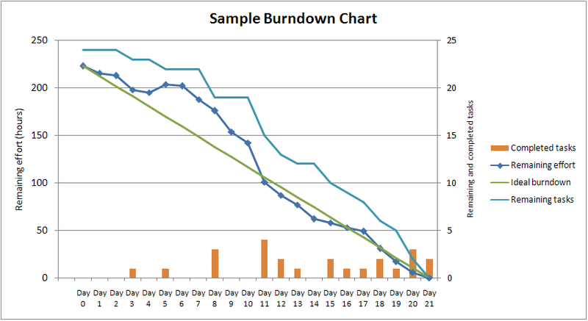
Sprint burn down
COMP319
© University of Liverpool
slide <number>
Notes:
Notice since this is showing progress relative to estimates if the developer usually underestimates
the time on the chart will always show overrun.
The burn down chart could
COMP319

Slide 11
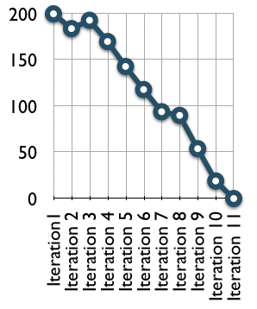
Release burndown
COMP319
© University of Liverpool
slide <number>
Notes:
Note this is marked usually in story points.
Needs careful measure of feature creep to understand why project is falling behind schedule.
COMP319

Slide 12
Scrum meetings
Sprint review meeting
  What was completed?
  Demonstration of product
  Review product backlog
COMP319
© University of Liverpool
slide <number>

Slide 13
Scrum master
  Builds the release plan
  Controls what is allowed into the sprint (checks for over-commitment)
  Manages daily scrum (removes obstacles)
  Acts as project manager providing all communication between the team and the management
COMP319
© University of Liverpool
slide <number>

